Slide 1


Team 18: Kubernetes
Based Attacks
Final Update Thomas Gumienny, Patrick Churchill, Albert Ma Sponsor: Sandip Roy TA: Sabyasachi Gupta
Notes:
Michelle

Slide 2
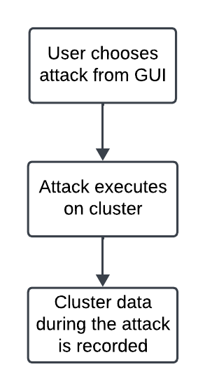
Project Summary
The US Navy is using Kubernetes to manage software. However, as a relatively new cyberservice, Kubernetes has a variety of cybersecurity weaknesses.
Develop a Kubernetes testbed that can simulate and collect the data of common types of attacks, and can also serve as a way to run more attacks
Notes:
Kyle

Slide 3
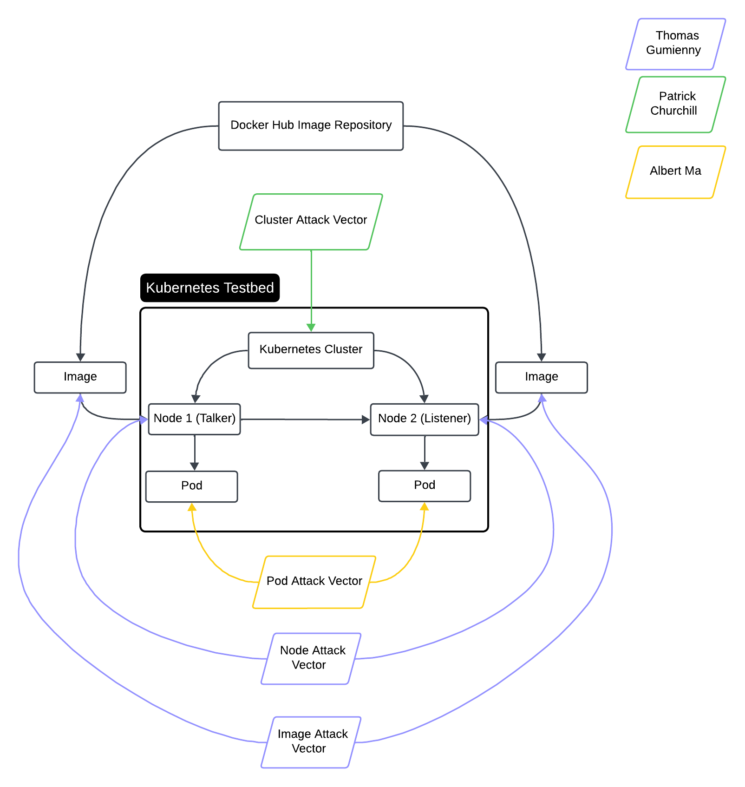
Project/Subsystem Overview
Thomas Gumienny - Image Attack
Image has similar name to normal docker image
When run, image consumes CPU/GPU resources
Albert Ma - Pod Attack
Set up target pod, and conduct reconnaissance on network
Gain access to target pod and container and all stored info
Patrick Churchill - Cluster Attack
Server Node applies pods upon Agent Node that overload the memory and CPU on Server Node, causing it to crash
Notes:
Eric

Slide 4
Image Attack Vector
Thomas Gumienny

Slide 5
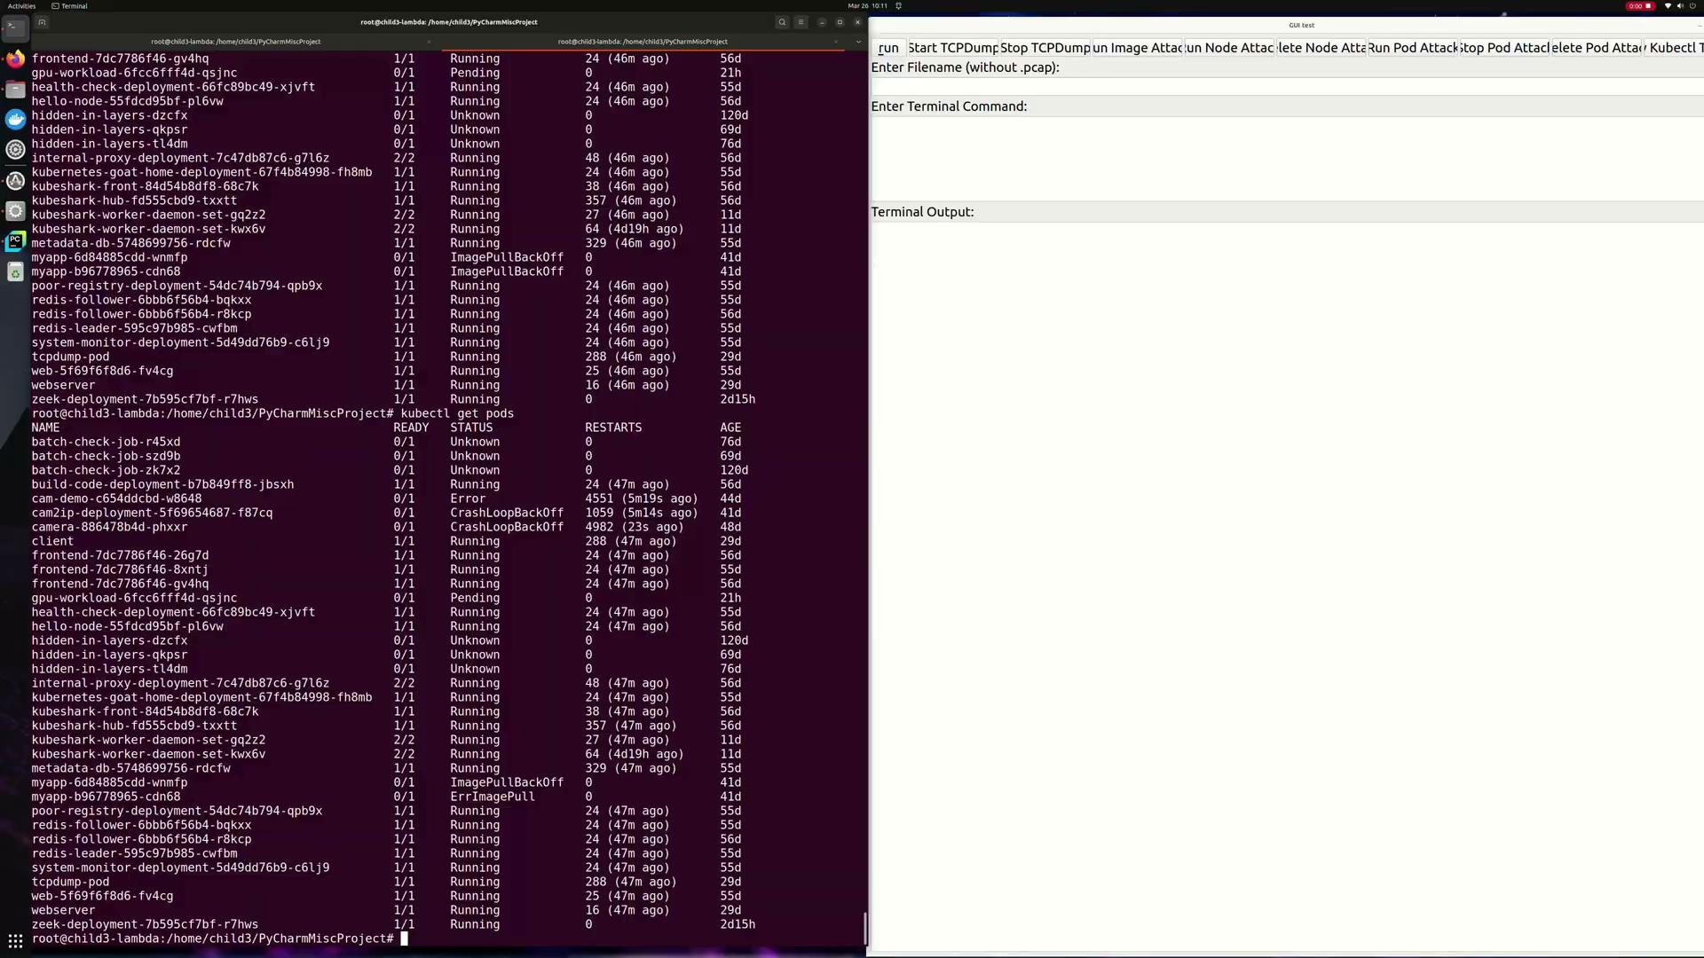
Node Attack Vector
Patrick Churchill

Slide 6
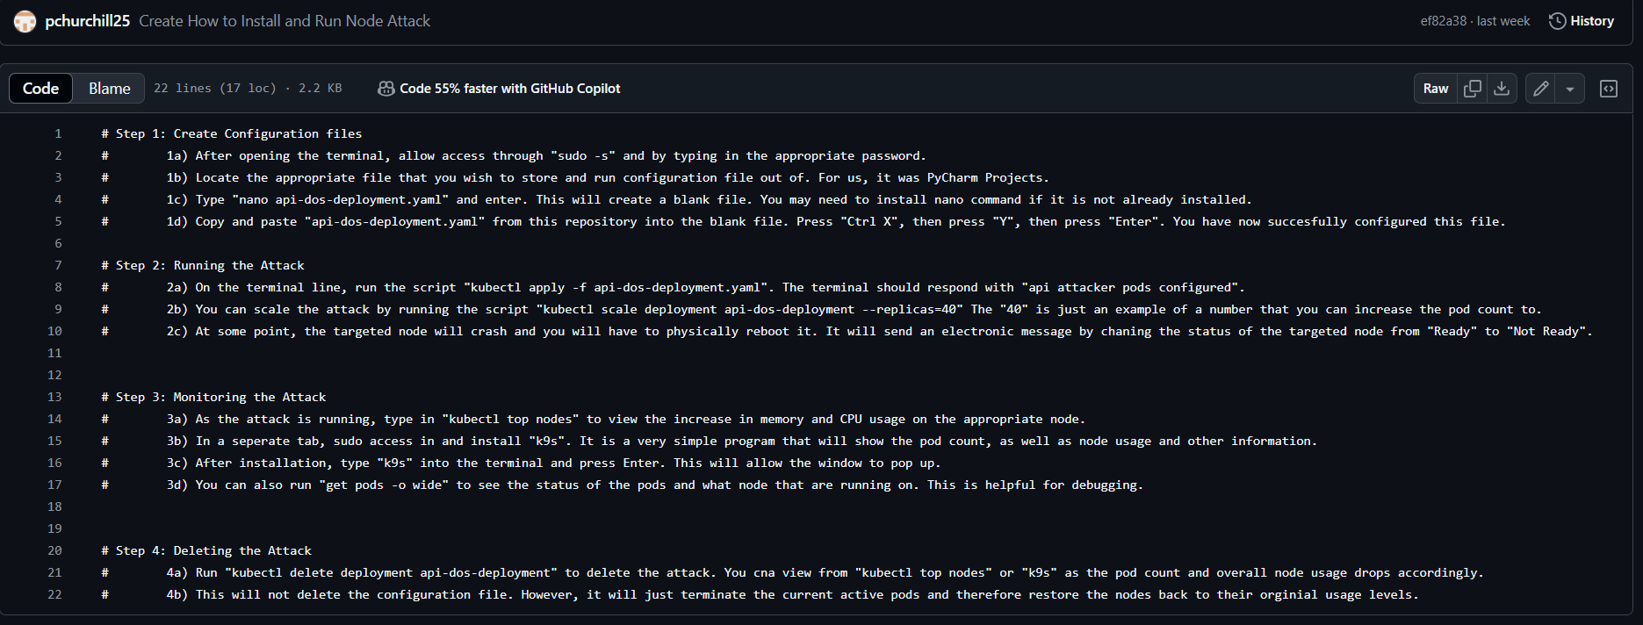
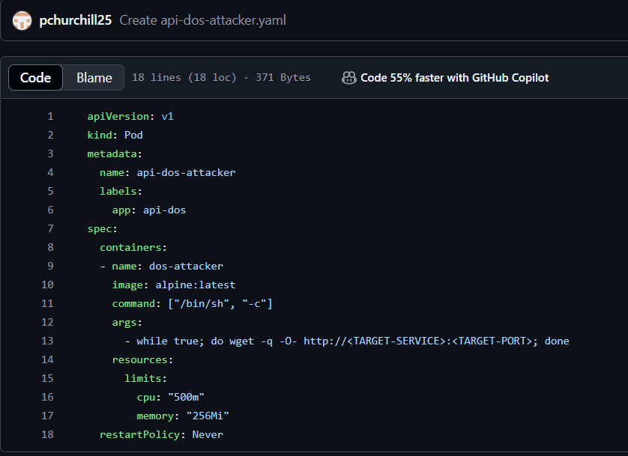
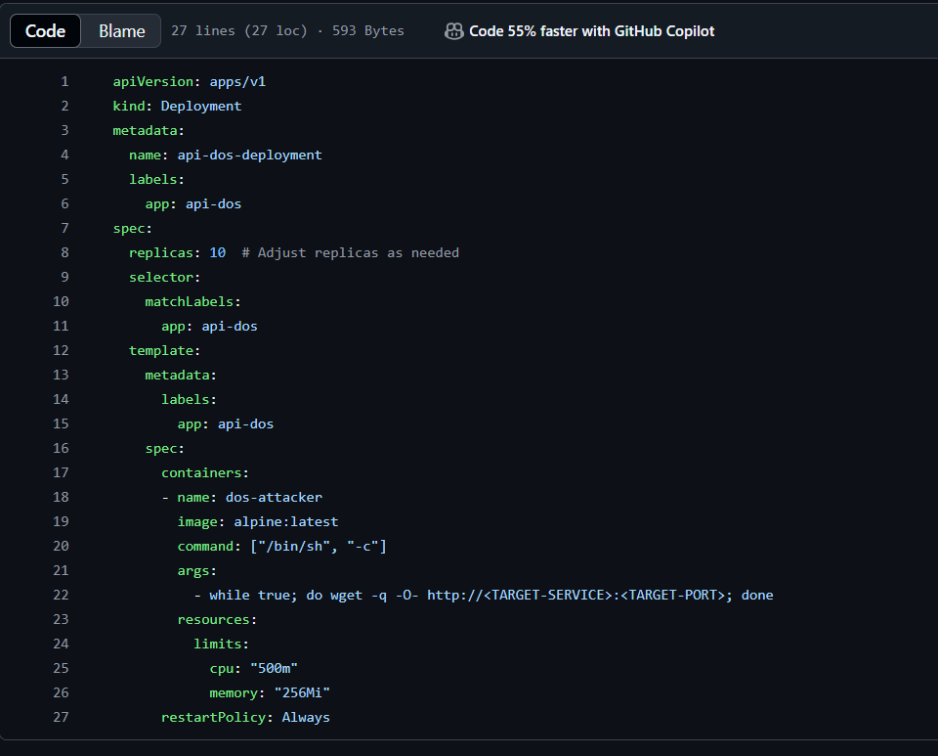
Node Attack Vector
Patrick Churchill

Slide 7
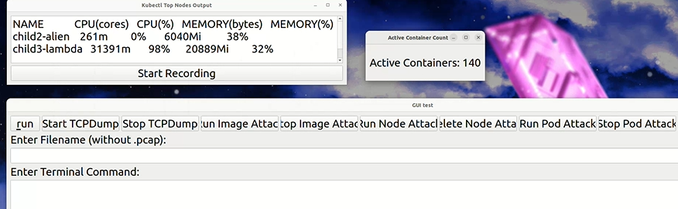
Pod Attack Vector
Albert Ma
Spam pull containers and simultaneously consume resources
Can be executed from the GUI
Can track a live count of active containers
Can stop an attack and delete all traces

Slide 8

Pod Attack Vector
Albert Ma

Slide 9
Conclusions
Major change from FSR/ICD was switch to GUI
Current status:
GUI can run all three attacks
GUI can record attack data
GUI can display ongoing attack data
System is working as intended
Attack install documentation needs to be finished
Notes:
Michelle

Slide 10
Thank You

